Slide 1
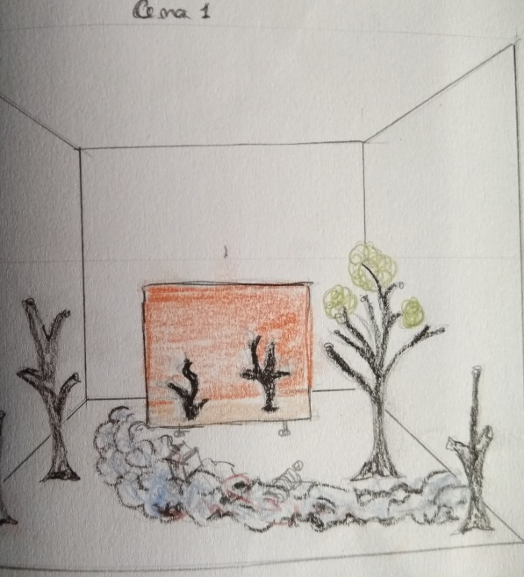
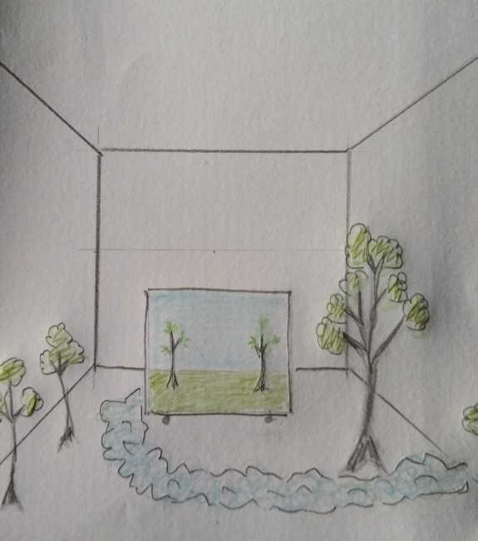
WORK SHOP
Construction of Theater Scenario
1. Some scenario building ideas
2. Practical activity.

Slide 2
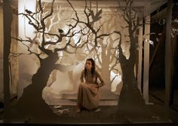
THEATER
Theater is an art form in which an actor or group of actors interpret a story for the audience in a certain place.
STORY
ACTORS
PLACE
With the help of playwrights or improvised situations, directors and technicians, the show aims to present a situation and arouse feelings in the audience.
LOVE
HOPE
JOY
HAPPINESS
SADNESS
ANGER

Slide 3
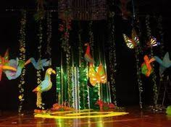
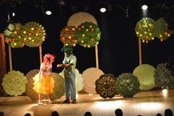
SCENERY
scenery
The scenery is used to give the space condition to the theater play.
The scenery, is the imitation, on stage, of indoor spaces (living rooms, offices,...), or external (street, garden,..), and others where the action takes place.
Organizing a scenery includes all the elements that contribute to establish an atmosphere and the imaginary sense of the show.
Recriation of space
Atmospheric effects
Characterization
Costumes
Lighting
Sound
Scenery are environments and objects produced with different types of materials where the visual is the most important.

Slide 4
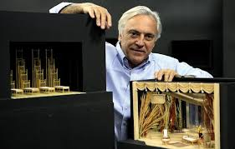
SCENOGRAPHER
The person responsible for the scenery is the scenographer, art director or set designer.
The scenographer, has initial training in the areas of design, architecture, fashion or visual arts.
The scenographer has a strong sense of teamwork and explores his creativity, in order to be able to imagine, create and recreate environments and universes, clothing and objects that are an integral part of the most different types of shows and artistic languages.

Slide 5
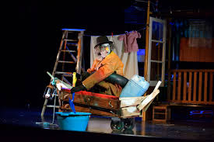
SCENOTECHNIC
directors
meeting
draw
project
script
read
scenographer
scenotechnic
After knowing the script and meeting with all the directors of the teams involved, the scenographer does the project and hands it over to the scenotechnic.
The scenographer is like the architect and the scenotechnic is like the engineer in civil construction.

Slide 6
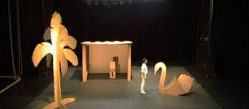
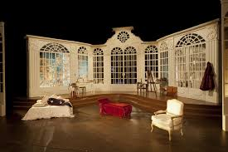
CREATING A SCENARIO
Scenarios should be simple, but with the indispensable to stimulate the viewer's imagination;
DON’T elaborate complicated scenaries;
DON’T choose and empty stage.
We can use painted panels, solid wooden structures, furniture and real objects or manufactured by the scenography technicians.
Some scenarios have special effects such as explosions, lights, movements, pieces that have to fall on the scene, for example: doors, chandeliers. In this case it is necessary to create protection mechanisms so as not to damage the stage where the play takes place.

Slide 7
CREATE A SCENARIO
Simplicity. This is a quality that the school theater must use due to limited financial and technical resources.
An office setting can be created using just a table and a pair of chairs, adding details like a bookcase, sofa, phone… etc
The use of many details has some problems in changing the scenario such as arranging the material in the change and the time to do it.
The change in scenario needs to be fast. It is also better to have a trained group to do these changes in a noiseless way and without accidents.

Slide 8
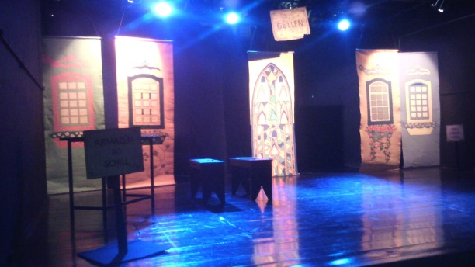
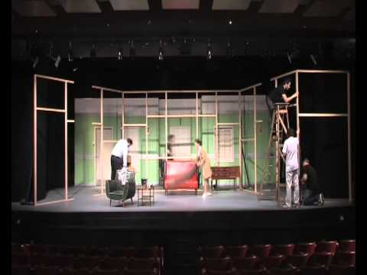
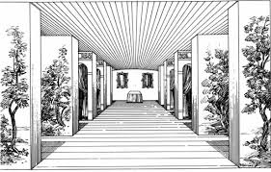
CREATE A SCENARIO
The basic element of the cheapest and easiest scenarios to be changed and saved are the canvas panels or scenery – paper painted and stretched in a wooden frame or other process.
Panels made of scenery paper or canvas are usually excessively light, show folds, ripples or move with drafts; they need to be very fixed.
External settings such as gardens, woods, open fields, or a street can be painted on a larger panel or on a suspended and well-stretched canvas.
The painting of a panel should show the most convenient perspective in relation to the audience.

Slide 9
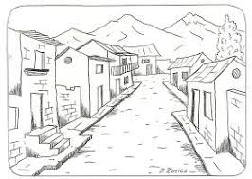
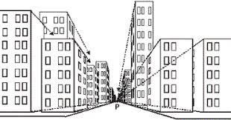
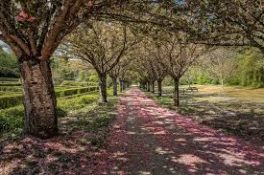
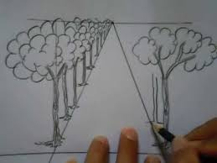
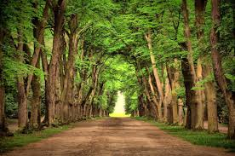
CREATE A SCENARIO
In perspective, we create a horizon line and a vanishing point where all the depth suggestion lines are drawn.

Slide 10
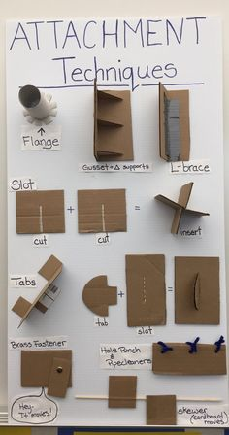
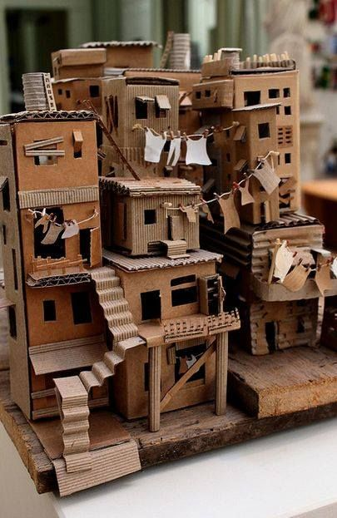
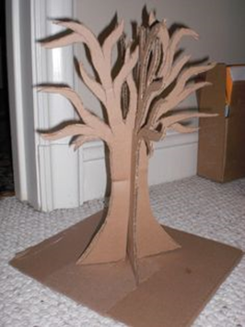
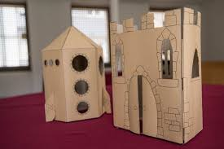
CREATING OBJECTS FOR A SCENERY
With the use of cardboard, lamps, old radios, oratories, pictures hung on the wall or on a panel, columns, etc. can be improvised.
A beam can be imitated with cardboard folded into its own shape, streaked with brown crayons to imitate wood fibers, and painted with varnish.

Slide 11
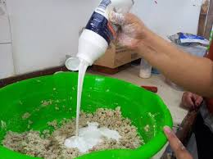
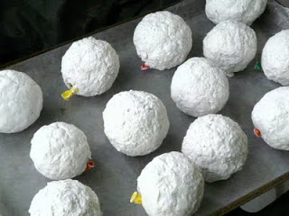
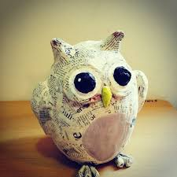
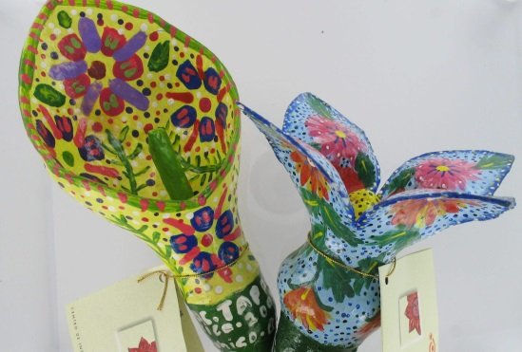
CREATE OBJECTS FOR A SCENERY
Painted papier-mache can be modeled to imitate rocks, vases, artificial plants…
To make the dough, tear a sheet of newspaper into thin strips, place it in a bowl of water and leave it for a day.
2. Smash the newspaper and squeeze it in piles to remove all the water, remove the moist balls.
Add the white glue and knead until the glue is incorporated into the newspaper, knead very well and it will be ready.
4. The dough should be used on the day it was made or stored in the refrigerator.
5. After the object is done it should dry for two days.
6. To paint use acrylic paints.
7. Once ready, apply a matte or shiny spray varnish to finish.

Slide 12
CARES TO TAKE
Any structure in which an actor must sit or walk on it must be firm enough that it does not collapse and hurt people.
It is necessary to keep at hand a reserve of the materials most used in the assemblies: staples, nails, spray paint, etc. so that the assembly can be done without delay, in the creation phase or in the reassembly between one act and another.
The pedagogical play uses volunteers, which represents a risk. The use of electric saws, powerful staplers, and other tools requires some prior training in the correct and safe handling.
The representation made in the classroom or in the school auditorium does not normally have lighting resources beyond the basic system. Improvising a system can be risky and cause a fire. An electrician's opinion should be sought.
Any risk of fire must be avoided: fireworks, lighted candles, etc.

Slide 13
PRACTICAL WORK
Paint a butterfly, a bird, a fish or a flower to use as an adornment in the piece “Water… water…”.
Use a cardboard cutout with a skewer stick.
Paint with acrylic paint using your creativity.
Thank you for your participation

